Slide 1

Converting casual users to members
Alexander Fastner

Slide 2
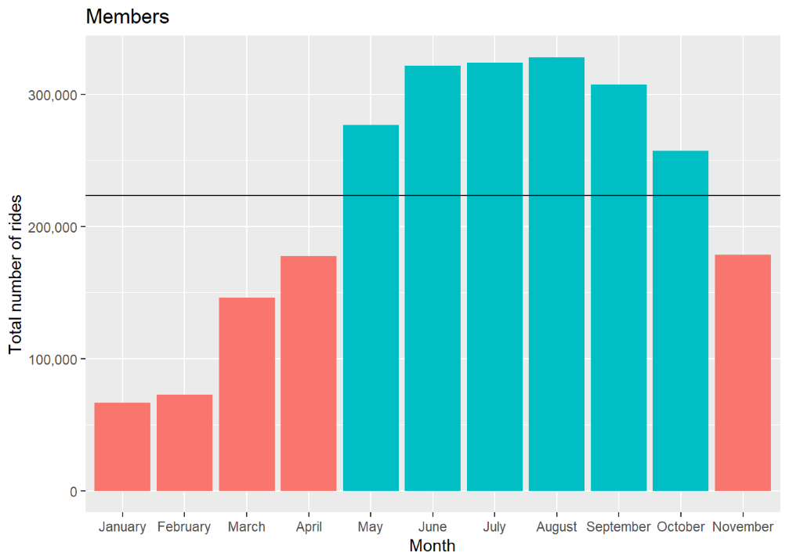
Most use during summer months
Notes:
Both members and casual users make the most use of cyclistic during the summer months. Likely due to it being Chicago and no one biking in the winter…

Slide 3
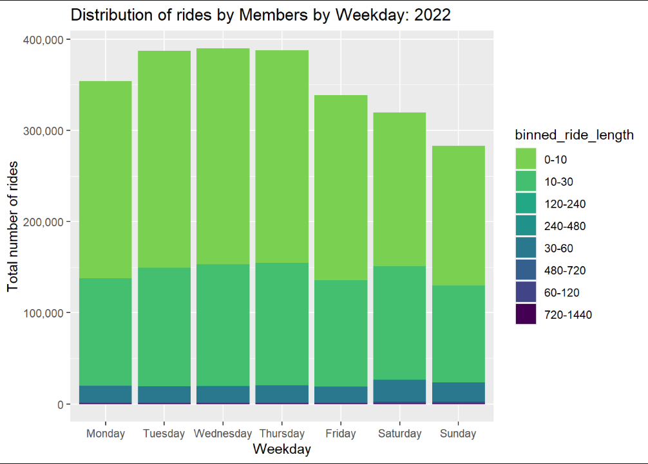
Members take short trips
Notes:
When looking at the binned distribution of trips we can see that the majority of members take very short trips (< 30 min). Casual users generally take slightly longer trips - likely leisure or tourism.

Slide 4
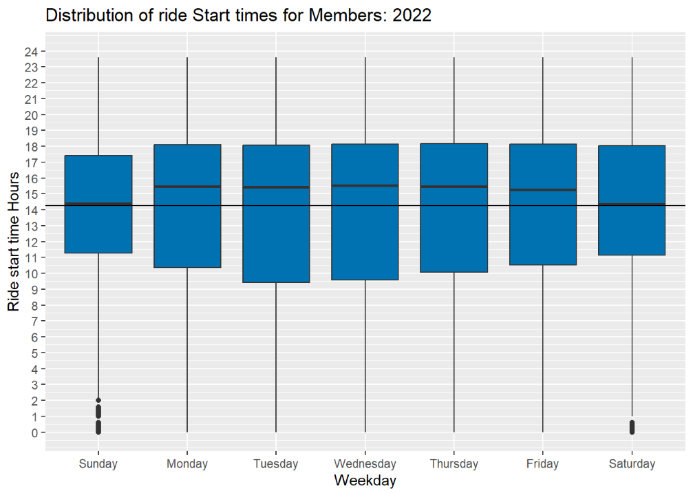
Notes:
When we combine this with temporal data, we see that members likely make use of Cyclistic to get to and from work, or for a midday ride. Perhaps for lunch.
Perhaps an opportunity to advertise with companies, or restaurants.

Slide 5
Most popular locations
Most popular locations | Number of trips started | Number of trips ending
1. Streeter Dr & Grand Ave | 69292 | 70550
2. DuSable Lake Shore Dr & Monroe St | 38164 | 39752
3. DuSable Lake Shore Dr & North Blvd | 36873 | 37444
4. Michigan Ave & Oak St | 36266 | 37280
5. Wells St & Concord Ln | 33111 | 33231
Notes:
These are the most popular starting and ending spots for our customers. As they are the locations with the most traffic we should advertise at these stations to get the most attention from potential new customers.
We can also partner with restaurants or companies near these areas and offer bulk subscriptions to companies, or discounts/coupons at restaurants.

Slide 6
Key takeaways
The best time to market is in the summer months (May-Oct), during the week, in the early afternoon around 2
Best places to market are (Streeter Dr & Grand Ave, DuSable Lake Shore Dr & Monroe St, DuSable Lake Shore Dr & North Blvd)
Offer bulk subscriptions/discounts to companies near these stations
Work with restaurants to incentivise people to bike to grab a nice lunch

